Slide 1

By: Team Jiminy Cricket

Slide 2









Slide 3




Slide 4

Voice Support
Saving/exporting the drawn images
Support for basic sounds during certain events
Support for Facebook chatting
Support for different drawing games

Slide 5


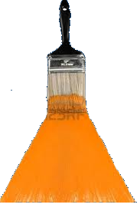


Slide 6


